Slide 1
Taco Truck ordering app usability study
26/7/2022
Latest Update
28/7/2022
Isa’s team
Wisal UX Designer

Slide 2
Table of Contents
Section 1 Study Details
Section 2 Themes
Section 3 Insights & Recommendations

Slide 3
Study Details

Slide 4
Project Background
we’re creating a new app to help Taco crumbs customers Place and pick up orders. So they can skip the in-store line and benefit from loyalty points.We want to create a product that can compete in the market, improve sales, and increase customer satisfaction.

Slide 5
Study Details
Research Questions
Participants
Methodology
How long does it take to place an order through the app?
What can we learn from the user flow? Or the steps the users take to order on their own?
Are there any parts where users are getting stuck?
Are there any features that frustrates the users?
How easy or difficult do users think the app is to use?
5 participants
Two males, two females, and one nonbinary individual, between the ages of 18 and 75.
Participants order at least twice a week.
45 of minutes per participant
United state, remote
Unmoderated usability study
Users were asked to perform tasks on a low-fidelity prototype

Slide 6
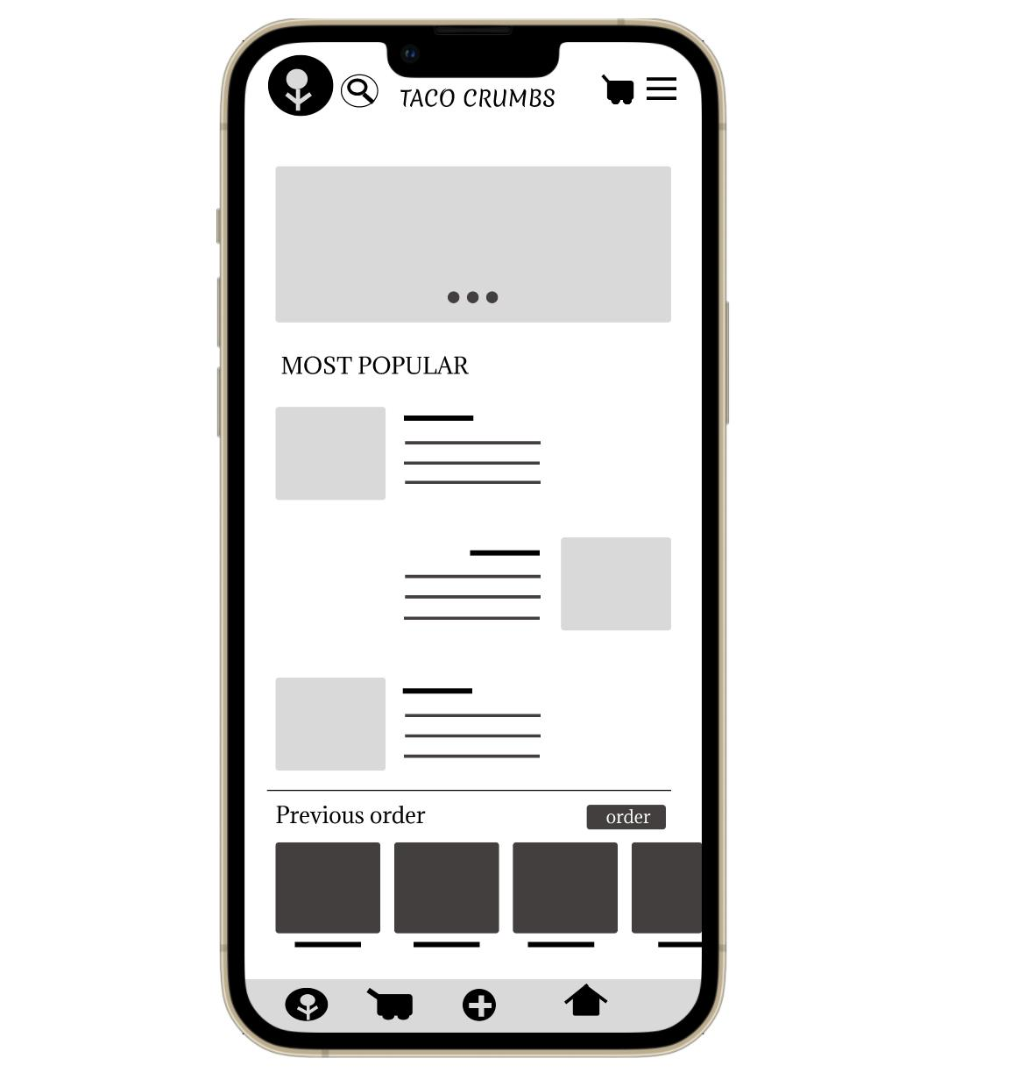


Prototype / Design Tested
The low-fidelity app prototype for Taco crumbs was tested and can be viewed Here:
https://www.figma.com/file/tP6hs2ZffzSx0Vdvm3fK3l/Taco-Truck-Ordering-App?node-id=0%3A1

Slide 7
Themes

Slide 8
People want buttons that are clear as to what they do.
4 out of 5 participants couldn’t find “start a new order” button.
Not all participants who wanted to start a new order expressed the same level of frustration.
“I couldn't find the start new order button and it was pretty hard for me to find it"
-Elena H, Taco consumer from Denver, colorado
a

Slide 9
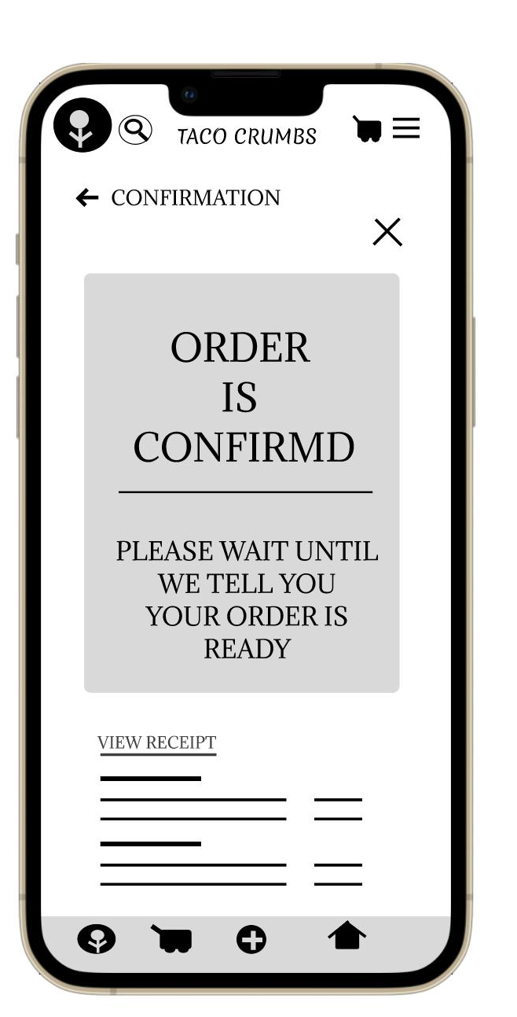
People wants more information on the order before confirming it.
3 out of 5 participants were annoyed with the lack of payment information before confirming their orders.
“i wish there was a page where I can view my cart for the last time with the new items added "
-John E, Taco consumer from Boulder, Colorado
a

Slide 10
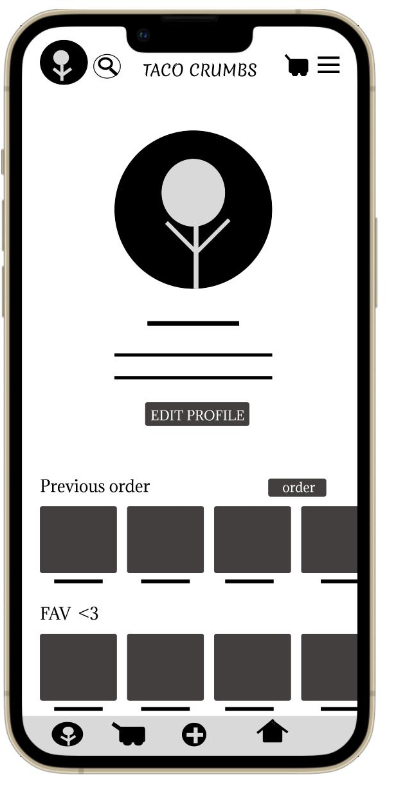
People wants to order their favourite dishes quickly and easily
3 out of 5 participants had hard time finding the “favourite items list”
“ I had to click random buttons to find "favourite items list" it’s a great feature but, why hide it”
-Natali N, Taco consumer from Highlands Ranch, Colorado
a

Slide 11
Insights & Recommendations

Slide 12
Research insights
Unable to start
A new order
Lack of payment information
Unable to find lists
In general users wants an easy way to start a new order
Users find it annoying when there isn’t enough information on their order before confirming
Users wants a short and quick way to access Favourite items list

Slide 13
Recommendations
Add a new feature that explains what each button in homepage means and how to use it.
Add “ favourite items” list in homepage and navigation to make it easier to access the list
Provide “order information” page before confirming it, in case users want to remove or add an item

Slide 14
After the update

Slide 15
a brief review of previous presentation information?
Section 1 Project background, study details, tested prototype.
Section 2 Themes
Section 3 Insights & Recommendations

Slide 16
Table of Contents for the updated Presentation
Section 1 Themes
Section 2 Insights & Recommendations

Slide 17
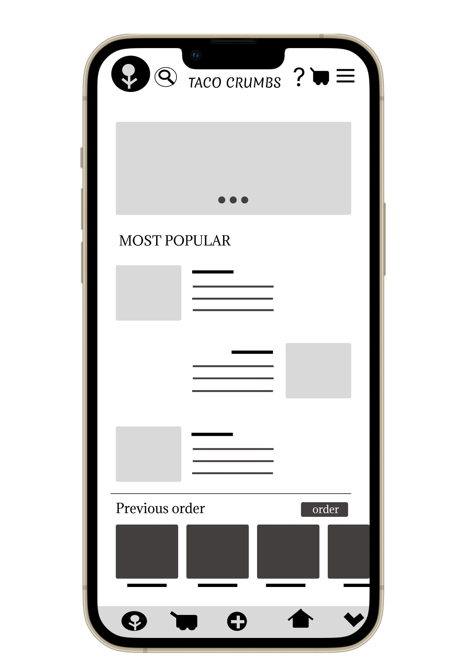
Prototype / Design Tested
The updated low-fidelity app prototype for Taco crumbs was tested and can be viewed Here:
https://www.figma.com/file/tP6hs2ZffzSx0Vdvm3fK3l/Taco-Truck-Ordering-App?node-id=0%3A1

Slide 18
Themes

Slide 19
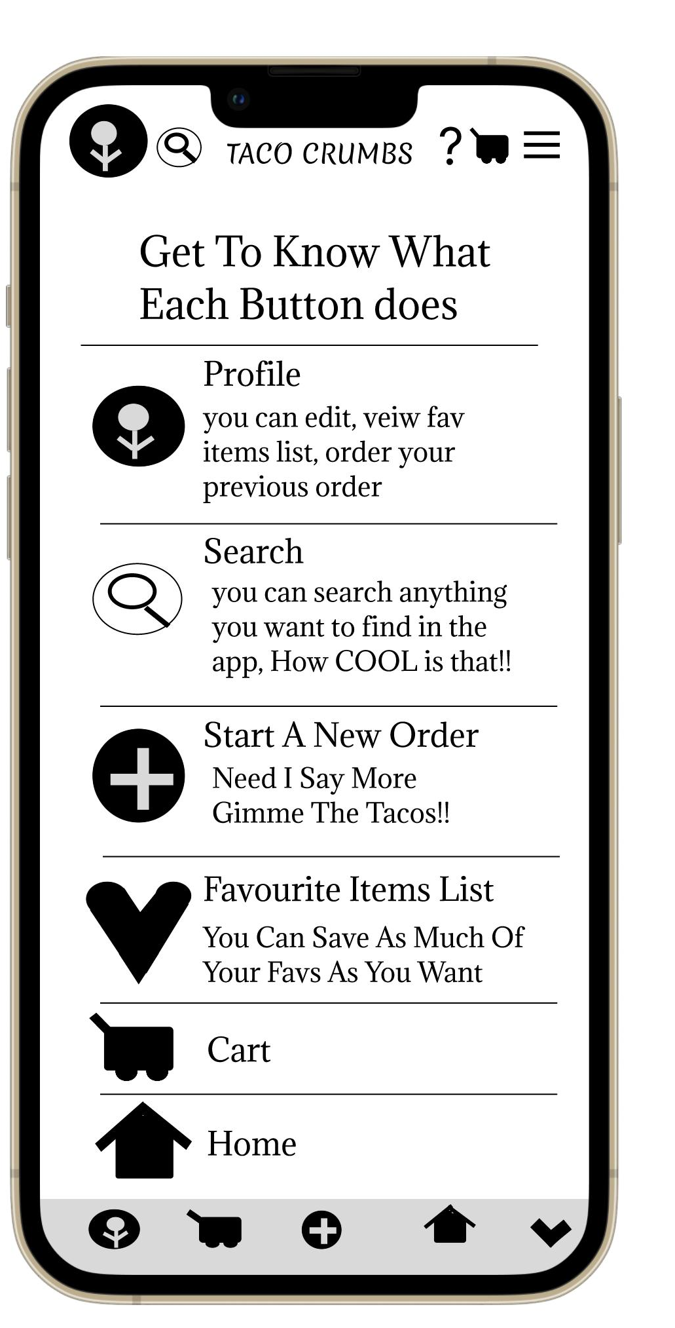
People wants buttons that are clear as to what they do.
We made sure to explain what each button will do, to make it easier for Taco crumbs customers to use the app
a

Slide 20
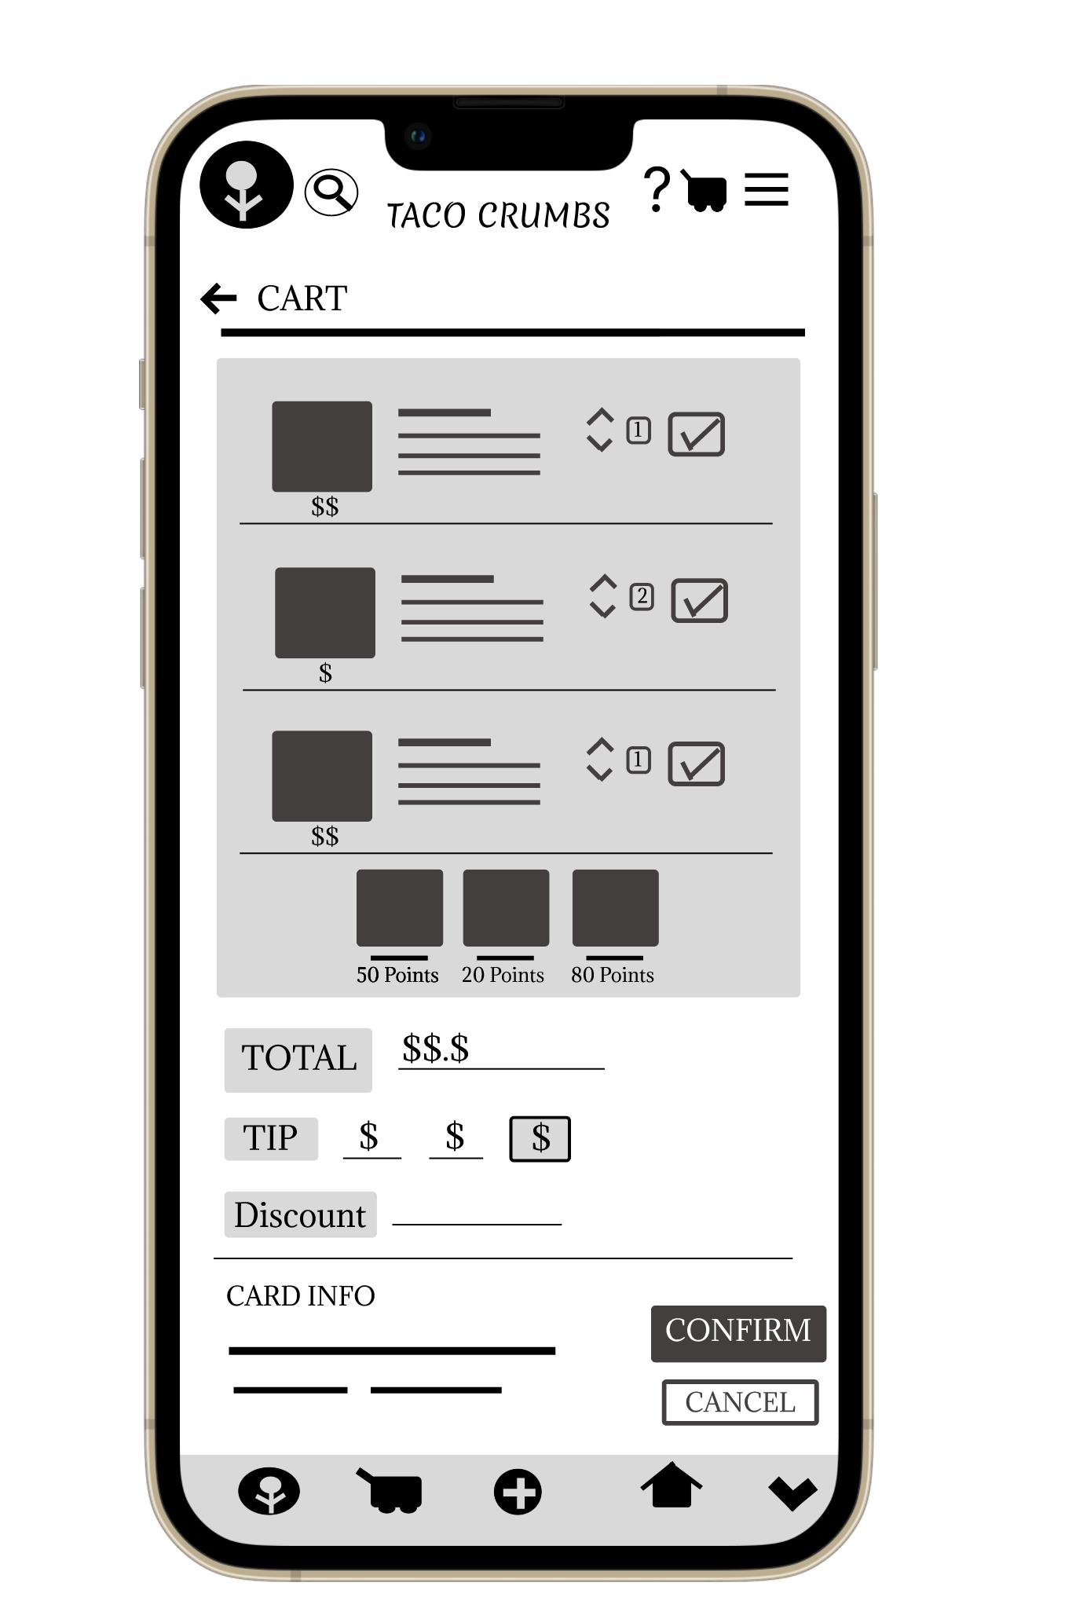
People wants more information on the order before confirming it.
We replaced page A with page B to make payment information page the last step before confirming the order

Slide 21
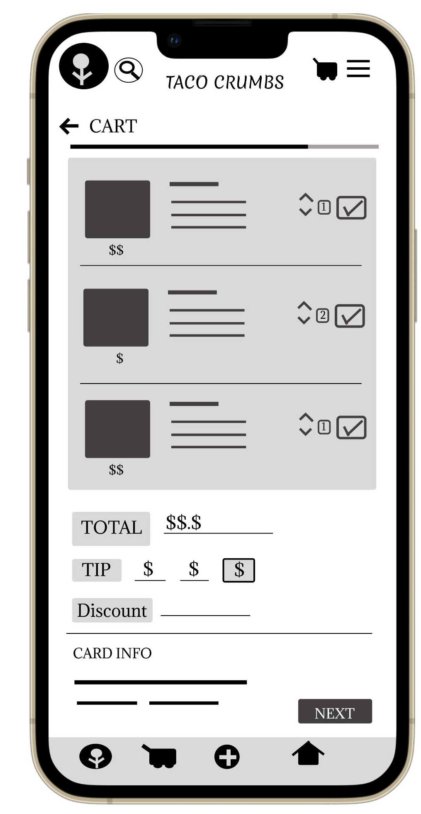
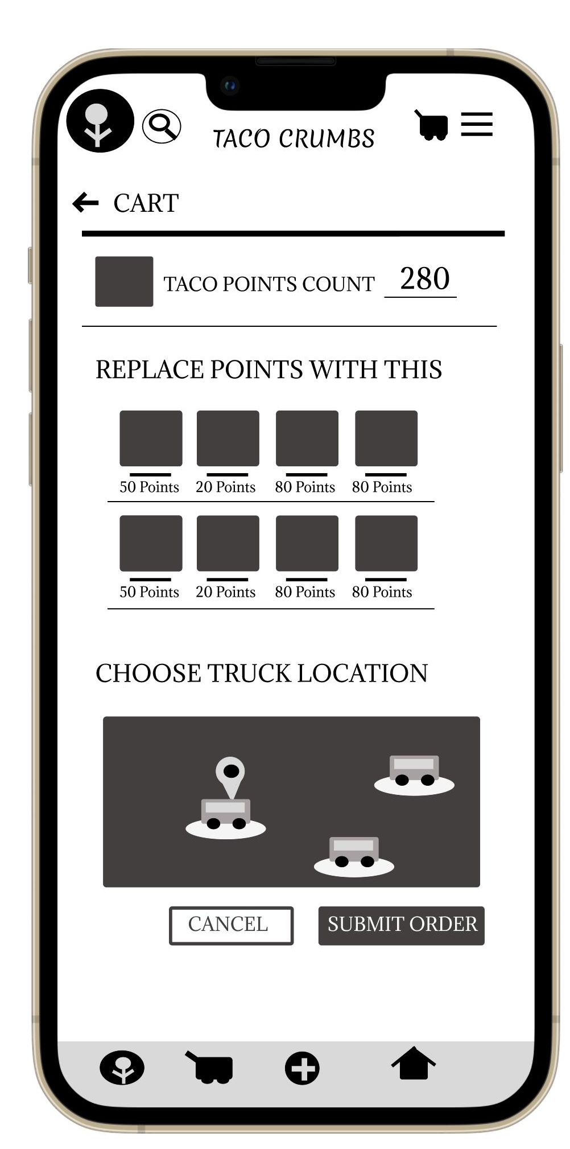
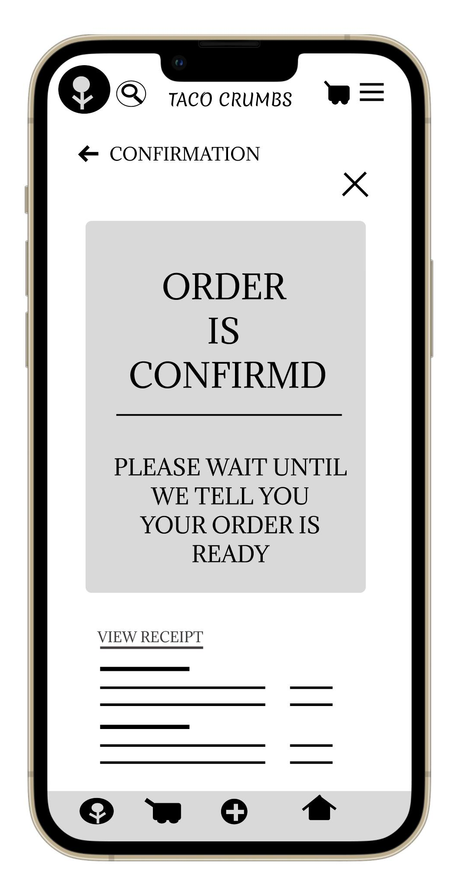
A - before

Slide 22
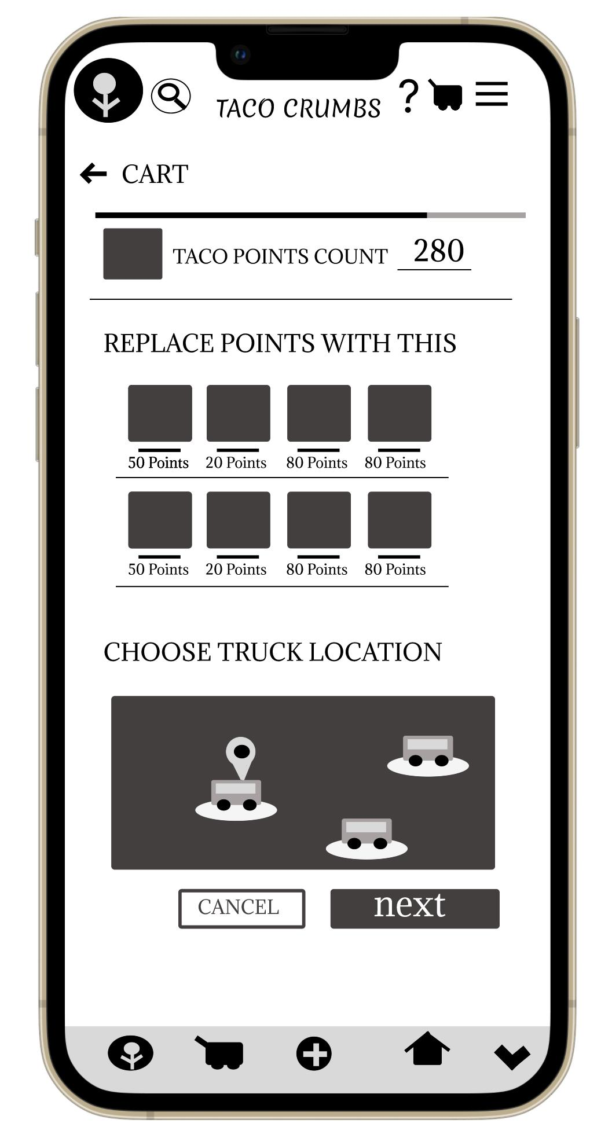
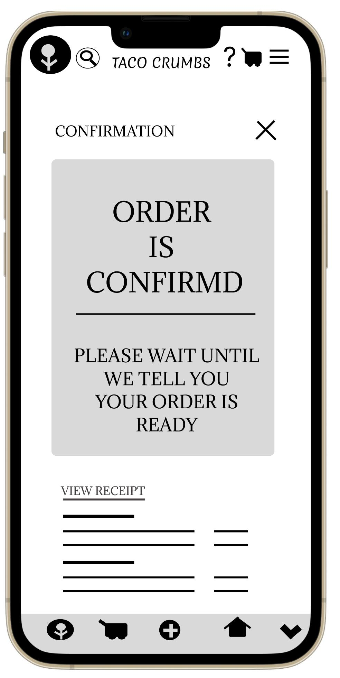
B - after

Slide 23
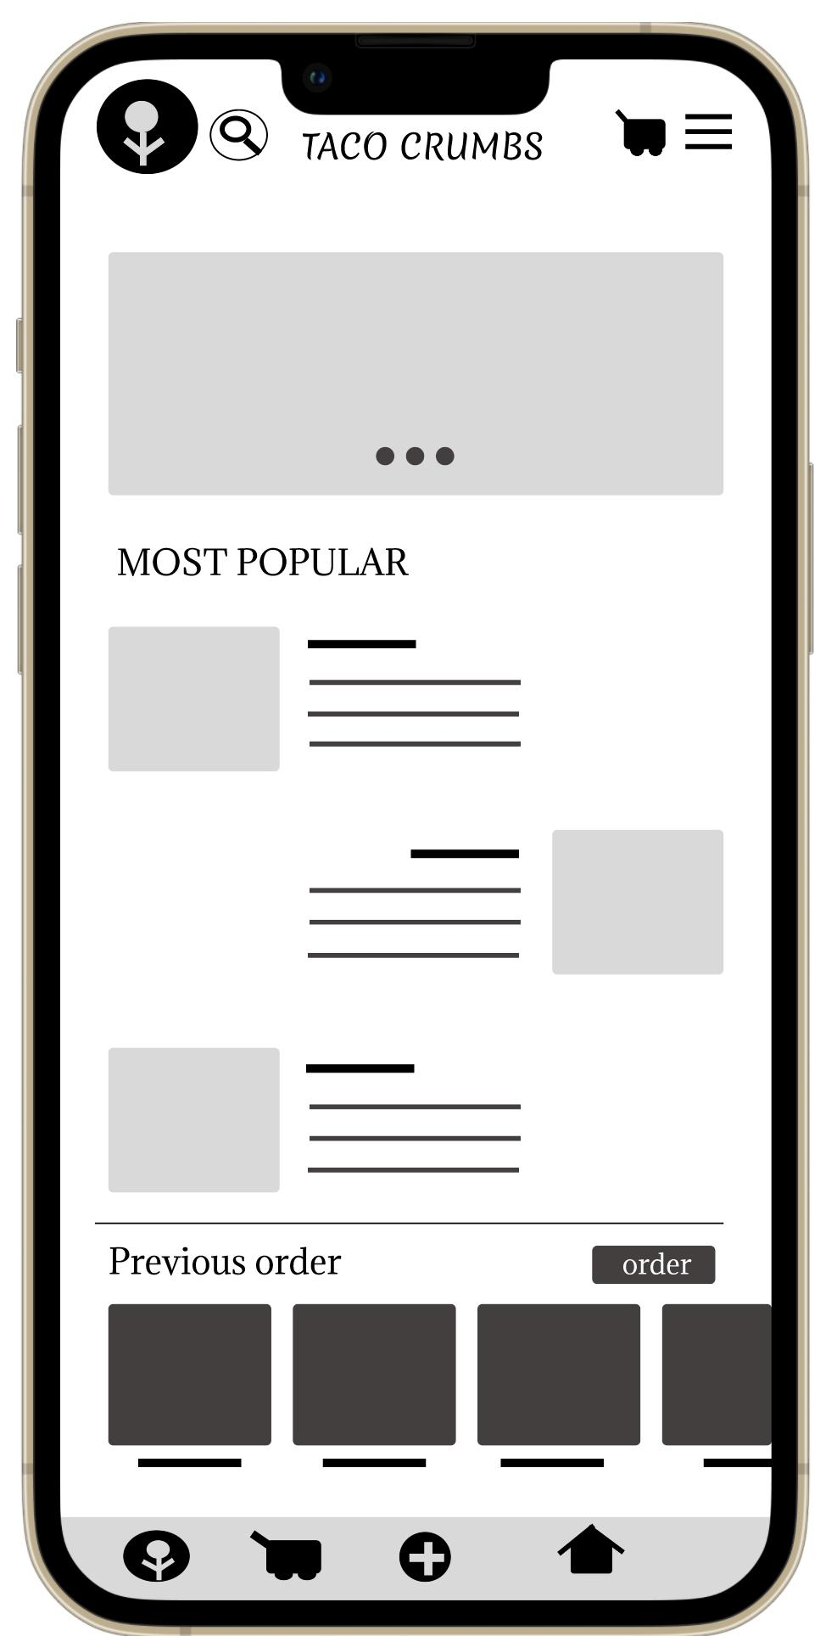
B - after
A - before
People wants to order their favourite dishes quickly and easily
By adding the heart icon to the bottom of the page We hope the users will have a quick and easy access to the “favourite items” list

Slide 24
Insights & Recommendations
& Next Steps

Slide 25
Research insights
Unable to start
A new order
Lack of payment information
Unable to find lists
After adding the explanation button, new users will find the ordering process much easier
We fixed it By replacing the pages and adding more payment information
We added the “favourite items” list to the bottom of the page with the other buttons to make reaching the list quicker

Slide 26
Recommendations
Add a “delivery” option to the app
Add “buying and delivering gift cards” feature to the app
Add more languages to the app

Slide 27
Next steps
Our next steps will be, making sure that the app can compete in the market.
improve sales.
increase customer satisfaction.

Slide 28
If you made it this far
Thank you!
And Have a good day<3

